Slide 1
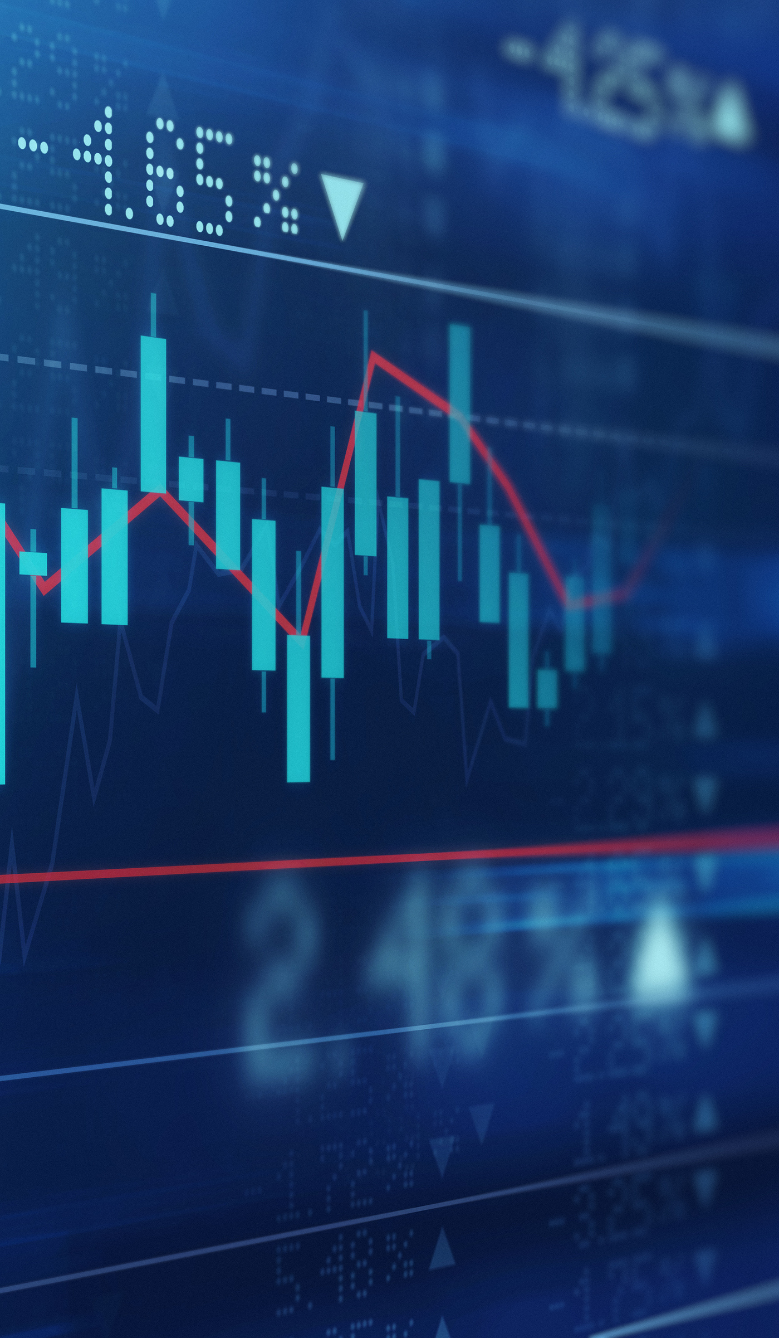
Stock Selection for Portfolio Optimization
How do we ‘properly select’ our portfolio?
Notes:
Hello Everyone,
I am Jorge Moya.
I am a mechanical engineer, but most importantly, I am a passionate data scientist.
I have spent most of my years working in financial analytics and lately I have also been contributing with marketing analytics.
In the next slides I would like to take you into the world of portfolio management and introduce you to my project
Stock selection for portfolio optimization.

Slide 2
The consensus reached from the majority of past studies is that active management DOES NOT provide superior performance compared to passive investing (Fama & French, 2010).
There is a large body of evidence that supports the case for passive management. Studies have shown that the vast majority of active managers underperform the market (study by Standard & Poor's, from January 1, 2003, to December 31 2013).

Slide 3
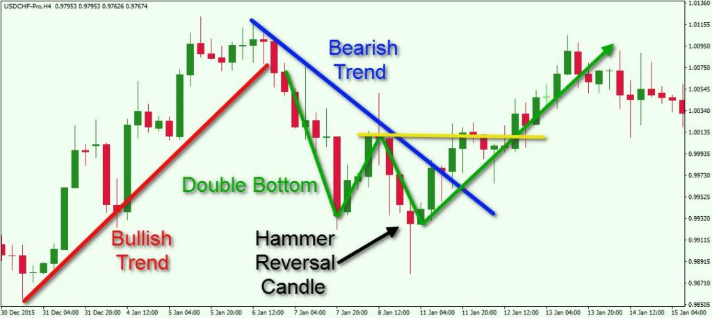
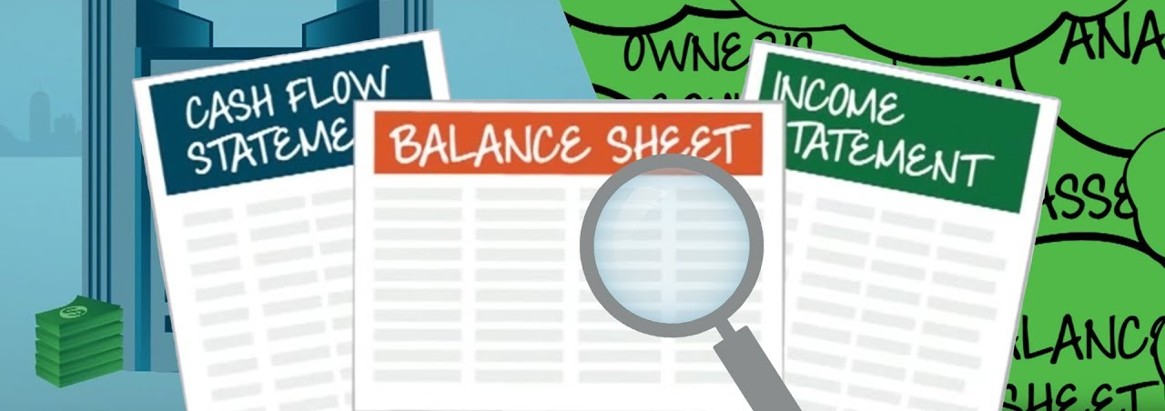
Technical Analysis
Fundamental Analysis

Slide 4
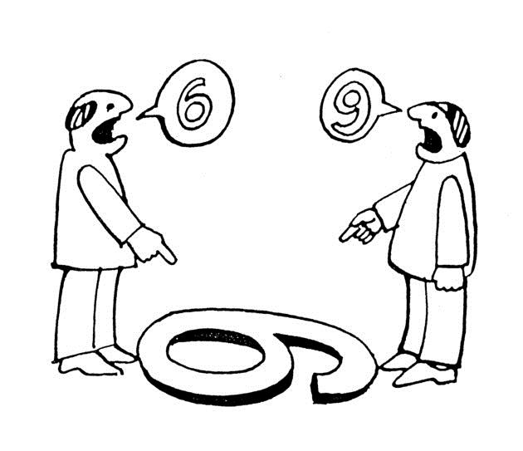
Technical Analysis
Fundamental Analysis

Slide 5
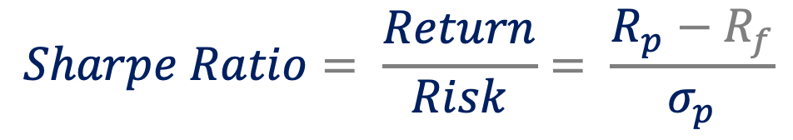
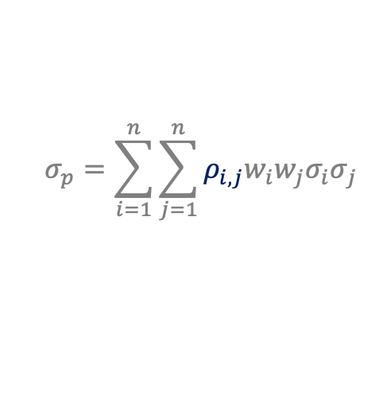
$$Sharpe Ratio= \frac{Return}{Risk}= \frac{R_{p}−R_{f}}{σ_{p}}$$
From Financial Mathematics
$$σ_{p}=\sum_{i=1}^{n}{\sum_{j=1}^{n}{{ρ_{i,j}w}_{i}w_{j}{σ_{i}σ}_{j}}}$$
Volatility from correlation
If correlation is negative, then that term becomes a subtraction

Slide 6
Low Return
Many assets
Low Risk
We are not only interested in the stock return but also interested in correlations between stocks
High Return
Few assets
Higher Risk

Slide 7
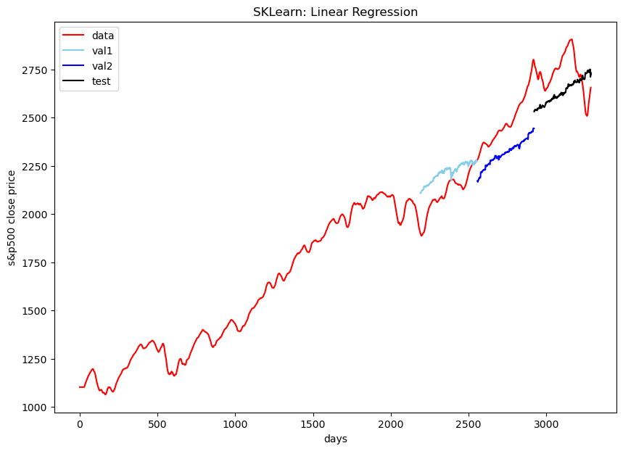
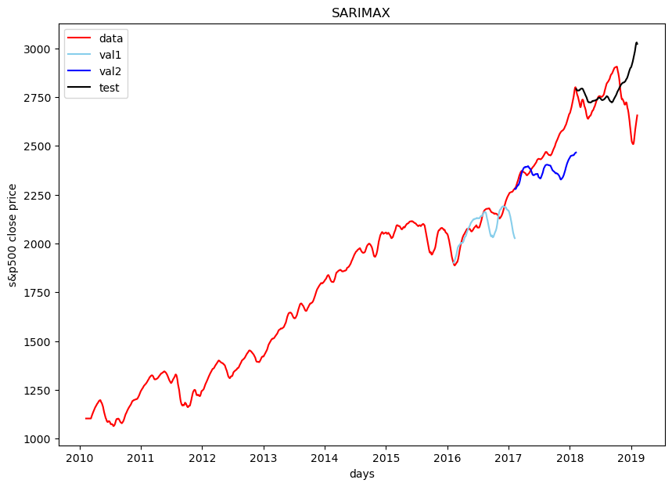
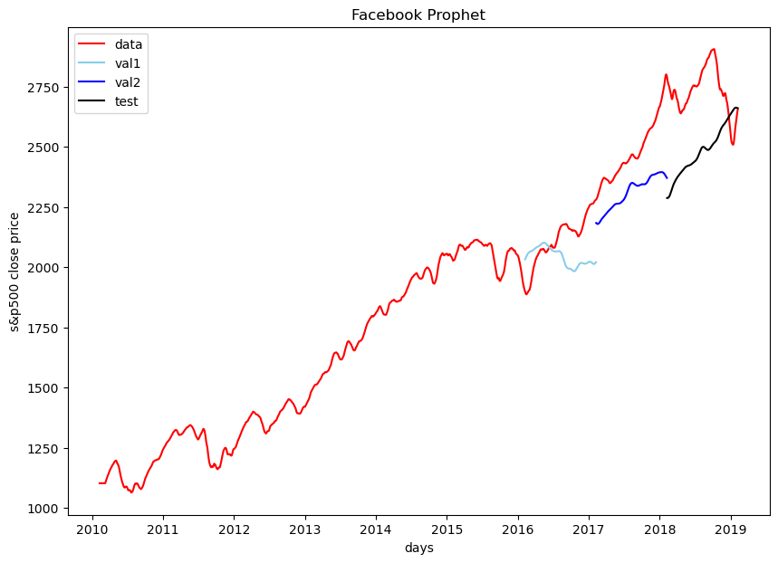
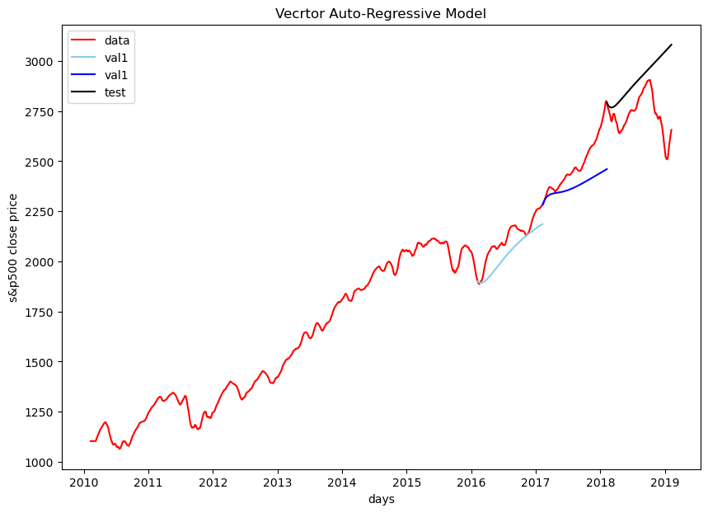
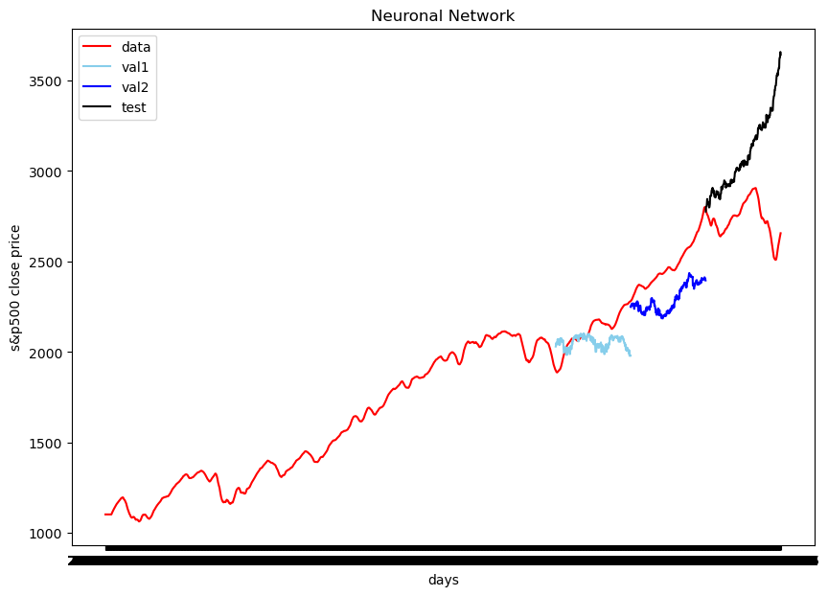
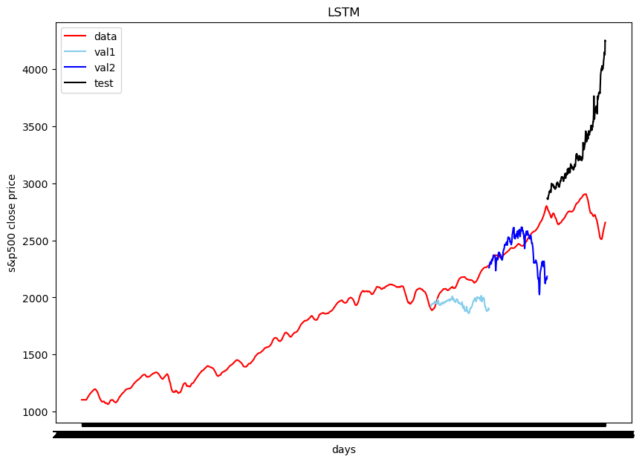
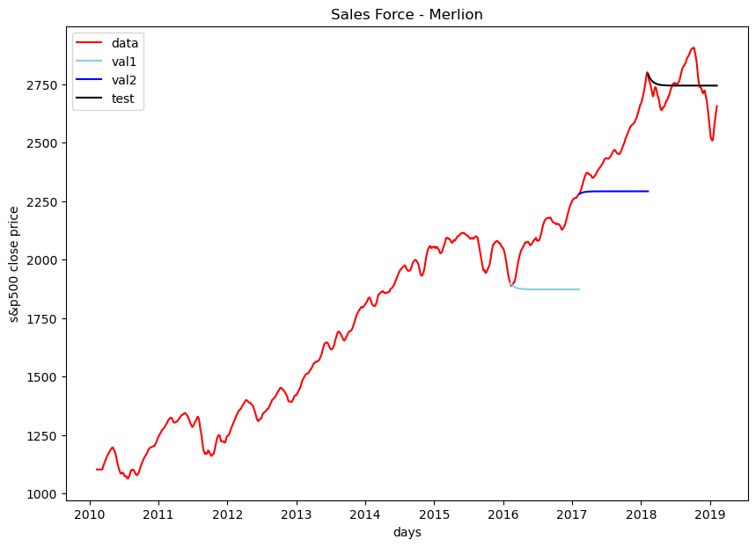
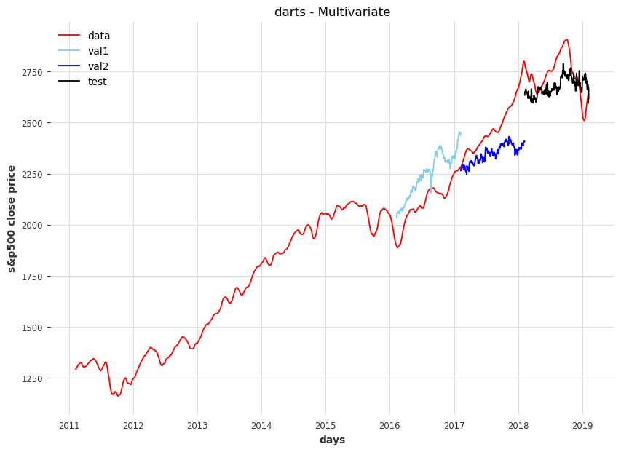
S&P500 stock’s Return predictive model
Better prediction of turning points

Slide 8
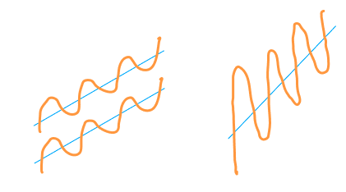
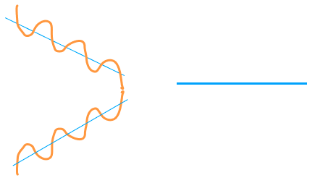
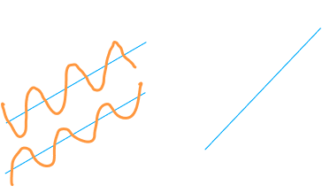
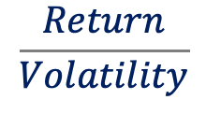
Optimization: Sequential Least SQuares Programming (SLSQP)
We are Maximizing the Sharpe Ratio
Maximizing Returns
Minimizing Volatility
$$\frac{Return}{Volatility}$$
Maximizing
30 stocks based on financial theory
1) Selecting the 500 optimal weights for the 500 stocks portfolio.
2) Selected the 30 stocks with the highest weight and normalized them

Slide 9
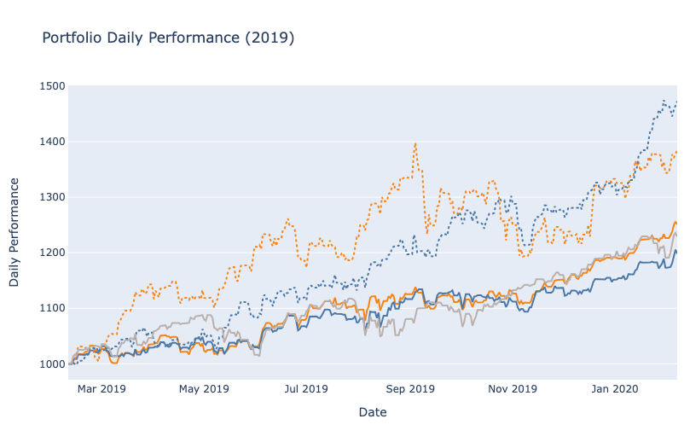
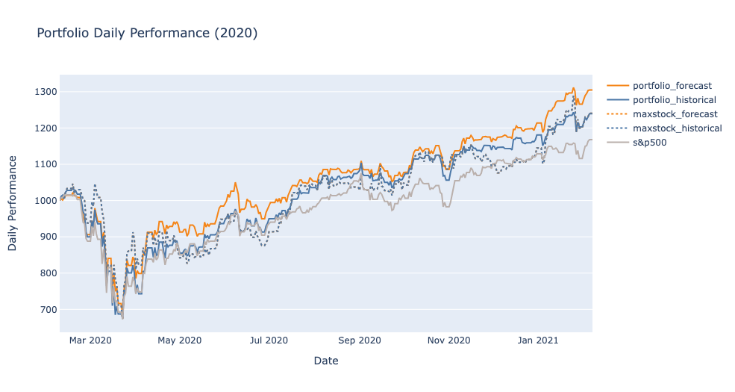
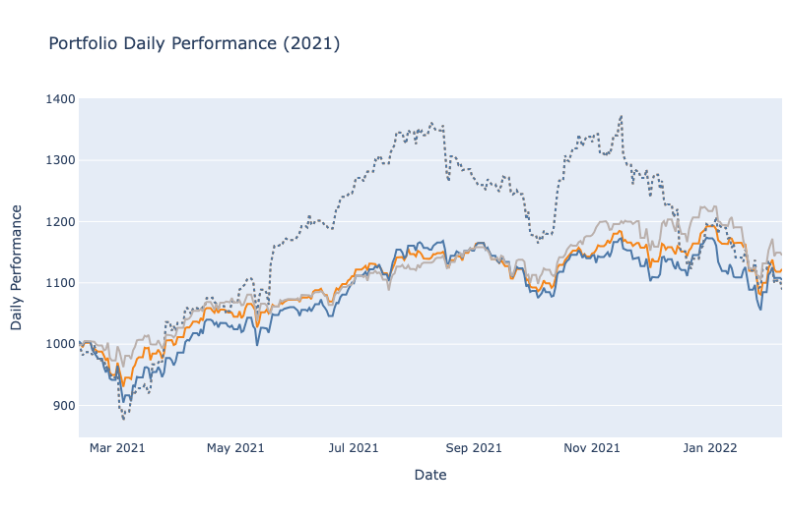
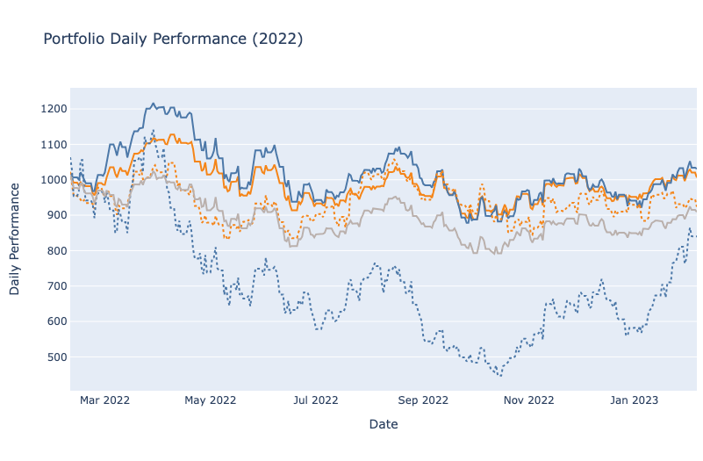

Slide 10


